Slide 1
Review
Requirements Engineering
  Feasibility studies
  Requirements elicitation
  Requirements analysis
  Requirements validation
  Requirements management
What artifacts in RE?

Slide 2
Chapter7
System models for requirement engineering process

Slide 3
What models should build in RE?
Let’s use RUP as a framework, the models should be presented in RE include:
Business model
Requirements model
Analysis model
analysis and design, in practice is inseparable.

Slide 4
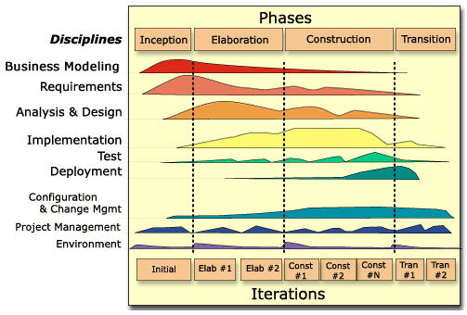

Slide 5
Note on the RUP diagram
From the diagram, requirements is elicited by:
  Business modeling----Business requirements---software requirements

Slide 6
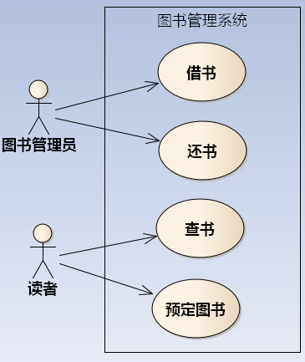
Requirements model
use case diagram
  Actor
  Use case and relationship among them

Slide 7
Requirements model
use case specification
  用例编号： 用例名：
  执行者：
    ××××（主）、××××（辅）
  前置条件：
  后置条件：
  涉众利益：
  基本路径：
  扩展路径：
  字段列表：
  业务规则：
  非功能需求：
  设计约束：

Slide 8
Requirements model
Developer oriented
Formal or semi-formal language
It is foundation of design and implementation.

Slide 9
Analysis model
Identifying the objects is one of the most difficult parts of analysis. Fortunately, MVC:
  Entity
  Boundary
  Control

Slide 10
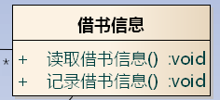


Analysis model
MVC pattern
Model
View
Control

Slide 11
Entity class/objects
Entity objects encapsulate the business data and business logic of the system.
also called model or business classes, are extracted directly from the statement of the problem (e.g., book).
1.Librarian inputs borrower’s information and submit it.
2.System validate information, if invalid, turn to Scenario-2;
3. Librarian enters books information
4. System alter this book’s status
5. System record borrowing information
6. System display successful information.

Slide 12
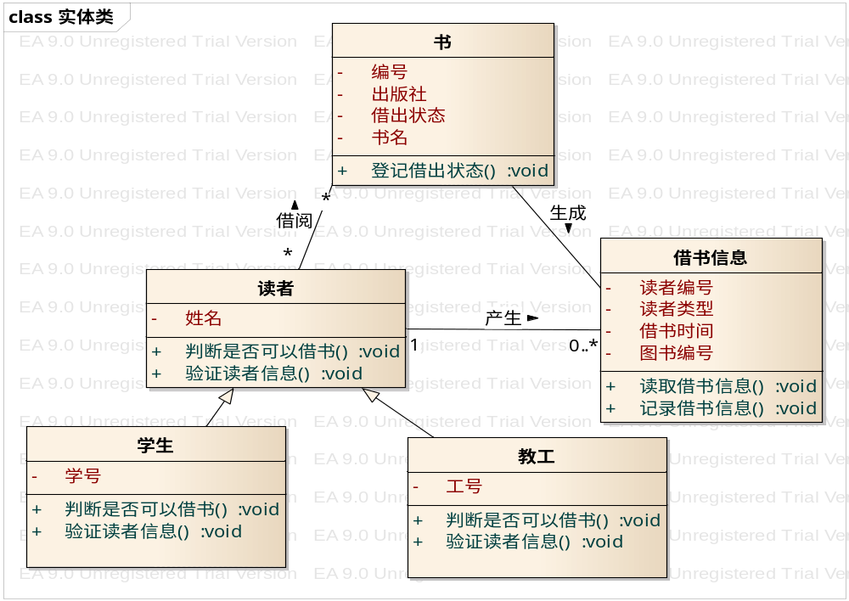
Entity class/objects
Class diagram

Slide 13
Boundary class/Objects
are used to create the interface (e.g., interactive screen or printed reports) that the user sees and interacts with as the software is used.
As a rule, each actor/use case pair forms a boundary object in the analysis model.

Slide 14
Describe Behavior
how the associated objects interact to realize the use cases.
UML uses two diagrams to describe the interactions between objects: sequence diagrams and collaboration diagrams.
Sequence diagrams show how objects interact over time.

Slide 15
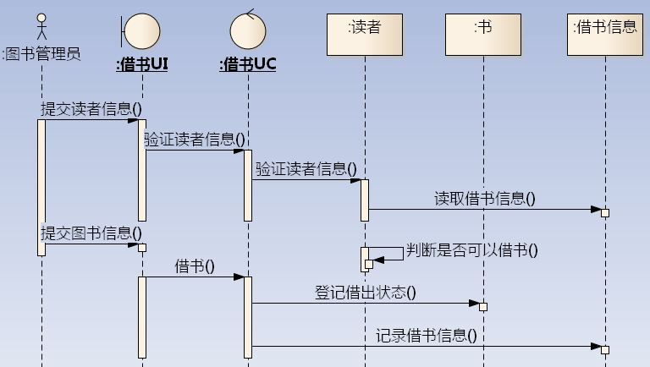
Analysis model
Sequence diagram

Slide 16
Key points
Software development is a modelling process
Models in RE

